Slide 1

The National
Economy

Slide 2
The National Economy
The Scope of Macroeconomics

Slide 3
The scope of macroeconomics
Microeconomics and macroeconomics
  Microeconomics studies the interrelationships between individual units: e.g. households, firms and industries. Macroeconomics studies the economy as a whole.
  Macroeconomics, like microeconomics, looks at issues such as output, employment and prices; but it looks at them in the context of the whole economy.

Slide 4
The scope of macroeconomics
The major macroeconomic issues
  economic growth
    This is a sustained growth in national output. All governments try to achieve stable growth by avoiding both recessions and excessive booms in business and general economic activity

Slide 5
The major macroeconomic issues….. Cont’d
unemployment
  It is the number of people who are actively looking for work but are currently without a job. Reducing unemploy’t is aim of every gov’t b’cos it represent a waste of human resource and a drain on government revenue.
  Inflation
    It is a general rise in prices throughout the economy.
    Rate of inflation is the percentage increase in prices over a 12-month period.

Slide 6
The major macroeconomic issues….. Cont’d
balance of payments and exchange rates
    Bal of paym’t is A record of the country’s transactions with the rest of the world
    Exchange Rate is the rate at which one national currency exchanges for another

Slide 7
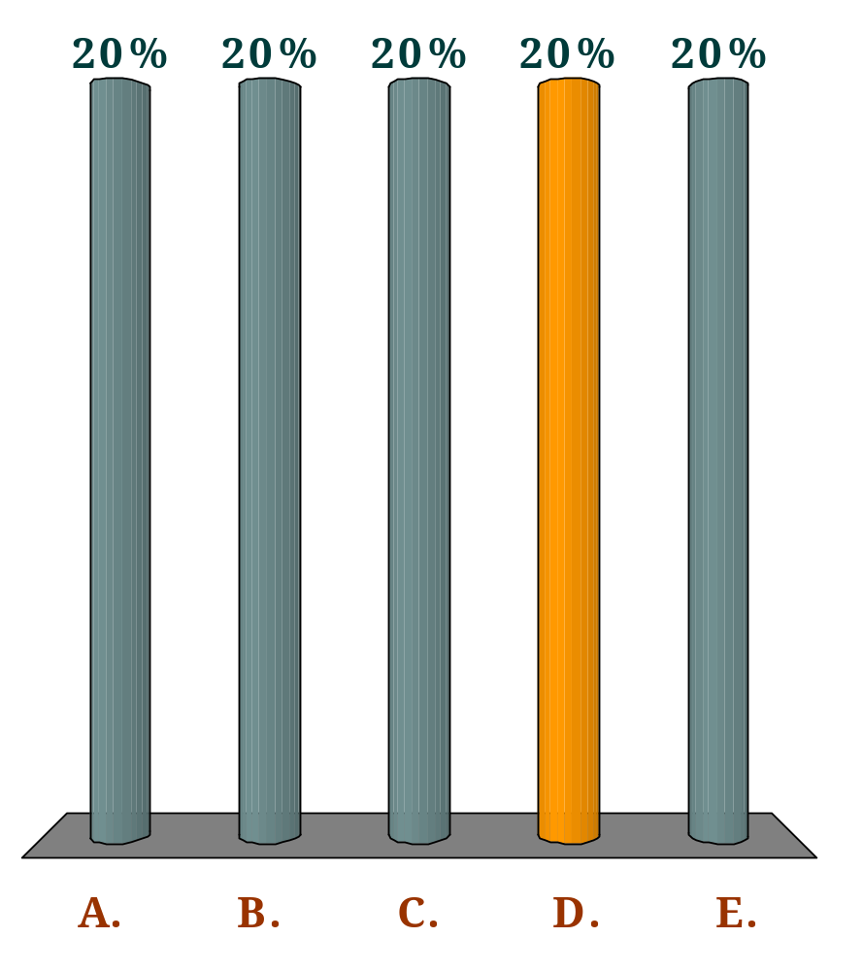
The rate of inflation is defined as:
Q
the difference in the price level this year compared with the same time last year.
the rise in costs over the previous twelve months.
the absolute increase in average prices over the previous twelve months.
the percentage increase in the weighted average level of prices over the previous twelve months.
the percentage expansion of the economy over the previous twelve months.

Slide 8
The scope of macroeconomics
From these 4 issues, Government macroeconomic policy aims at:
  High and stable economic growth,
  Low unemployment,
  Low inflation and
  avoidance of balance of payments deficits and excessive exchange rate fluctuations

Slide 9
The scope of macroeconomics
These goals conflict with each other, therefore, the order of priority in which they are pursued depends on the government’s preferences

Slide 10
Aggregate Demand (AD)
One way in which the four objectives are linked is through their relationship with aggregate demand (AD).
This is the total spending on goods and services made within the country.

Slide 11
Aggregate Demand (AD)
AD consists of four elements
    Consumption expenditure (C)
    Investment expenditure (I)
    Government spending (G)
    Exports (X) less Imports (M)
  AD = C + I + G + X - M

Slide 12
The Circular Flow of Income
It’s the diagram that shows the income received and payments made by each sector of the economy
It can be used to show how the four objectives are related to aggregate demand

Slide 13



The circular flow of income
Firms
Factor Payments
Consumption of
domestically
produced goods
and services (C_{d})
Households

Slide 14
The circular flow of income
The inner flow
  Households receive their income (factor payments) by selling their resources to firms
  Households spend their entire income on goods and services (i.e. they do not save)
  Firms pay out all this income they receive as factor payments to domestic households

Slide 15
The circular flow of income
In the real world, NOT all income are gets passed on round the inner flow; some is withdrawn. Others are injected into the flow from outside

Slide 16
The circular flow of income
Withdrawals (W) (or leakages)
  Are incomes of households or firms that are not passed on round the inner flow
  They equal the sum of:
    net saving (S) (i.e. net of drawing on savings)
    net taxes (T) (i.e. Taxes minus Transfer pay’ts)
    import expenditure (M)
  W = S + T + M

Slide 17
The circular flow of income
Injections (J)
  They are expenditure on the production of domestic firms coming from outside the inner flow of the circular flow of income
  They equal the sum of
    investment (I)
    government expenditure (G)
    export expenditure (X)
J = I + G + X

Slide 18
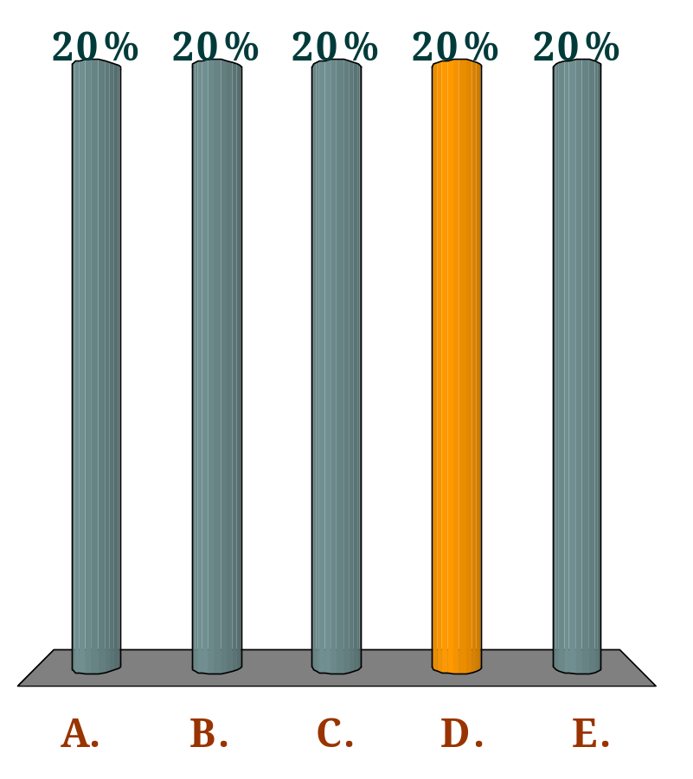
Assume that a Ghanaian insurance company sells insurance across the world.
In which component of Ghana’s circular flow of income would this be included?
Q
Investment
Consumption
Imports
Exports
None: they are transfer payments

Slide 19
The circular flow of income
INJECTIONS
Export
expenditure (X)
Investment (I)
Government
expenditure (G)
Consumption of
domestically
produced goods
and services (C_{d})
Factor
payments
BANKS, etc
GOV.
ABROAD
Import
expenditure (M)
Net
taxes (T)
Net
saving (S)
WITHDRAWALS

Slide 20
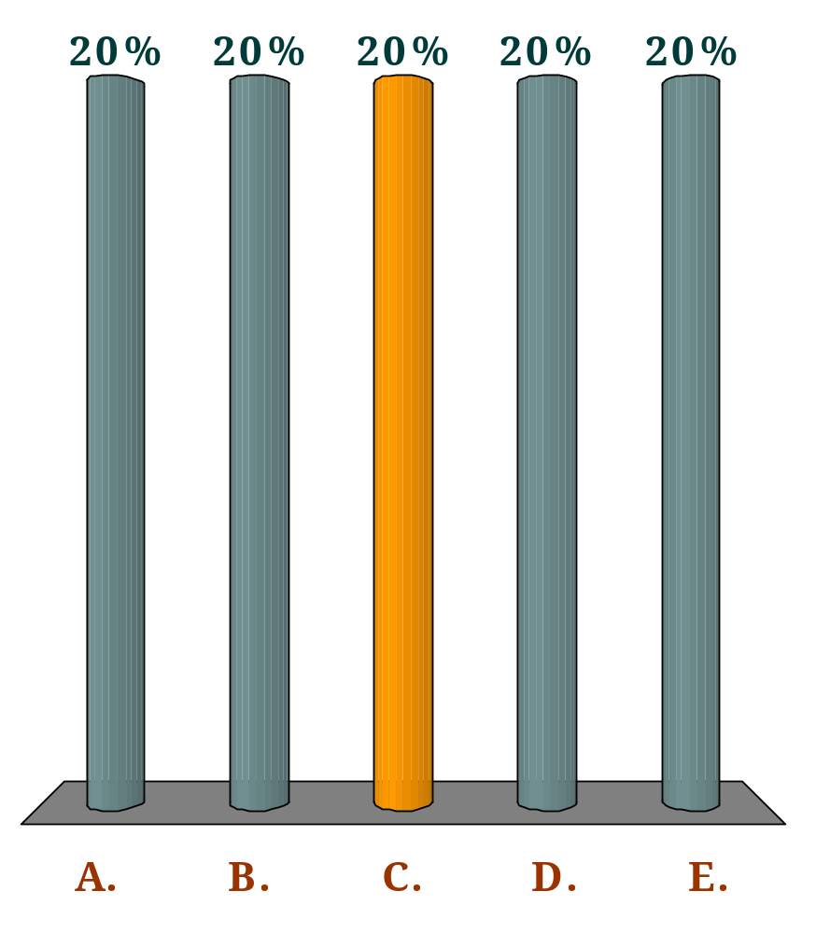
Aggregate demand consists of which one of the following?
Q
Total consumption + saving
Injections + withdrawals
Consumption of domestically produced goods + injections
Consumption of domestically produced goods and services + withdrawals
Consumption + (exports – imports) + (government expenditure – taxes) + (investment – saving)

Slide 21
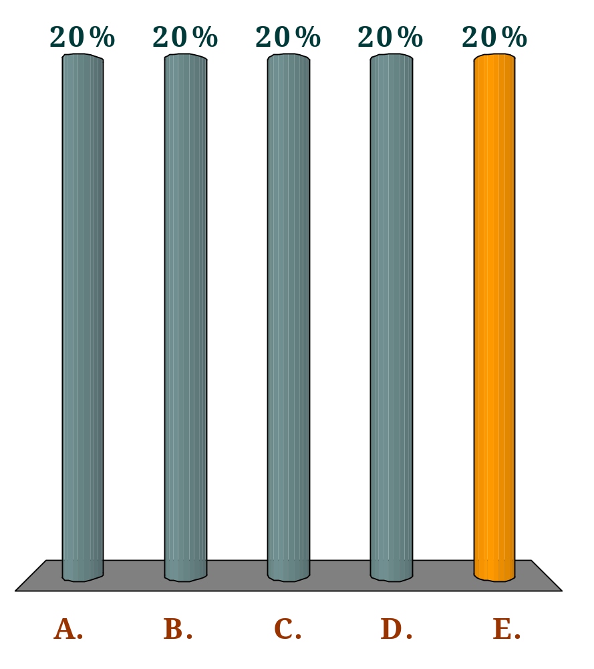
Which of the following would represent a rise in aggregate demand?
Q
A rise in saving.
A fall in investment.
An increase in taxes.
A fall in consumption.
A rise in exports.

Slide 22
The circular flow of income
The relationship between injections and withdrawals
  the links between them
    S loanable funds I
    T gov’t revenue G
    M foreign income X
BUT, planned injections may not equal planned withdrawals

Slide 23
The Circular flow and the 4 macro. objectives
If injections exceed withdrawals (J > W),
  national income will rise,
  unemployment will tend to fall,
  inflation will tend to rise,
  imports will tend to rise and exports fall.
The reverse will happen if withdrawals exceed injections.

Slide 24
Equilibrium in the circular flow
If injections exceed withdrawals ((J > W)
  the rise in national income will lead to a rise in withdrawals.
This will continue until W= J.
At this point, the circular flow will be in equilibrium.

Slide 25
The National Economy
Measuring National Income

Slide 26
National Economy
National income (output) is usually measured in terms of Gross Domestic Product (GDP)
Gross domestic product (GDP)
  is the total market value of all final goods and services produced within the country over a 12-month period

Slide 27
What Is Counted and Not Counted in GDP?
<number> of 38
GDP includes all items produced in the economy and sold legally in markets.
GDP ignores all transactions in which money or goods change hands but in which no new goods and services are produced. That is, it excludes financial transactions and income transfers since these do not reflect production E.g.. Lottery, Government Transfer Payments such as interest on Government Debt, Scholarships, etc.

Slide 28
<number> of 38
GDP excludes black market items, such as illegal drugs.
GDP excludes services that are produced and consumed at home and that never enter the marketplace.
  Caring labor, the work that is normally produced by women.

Slide 29


Exclusion of Output Produced Abroad by Domestically Owned Factors of Production
<number> of 38
GDP is the value of output produced by factors of production located within a country. Output produced by a country’s citizens, regardless of where the output is produced, is measured by gross national product (GNP).

Slide 30
Measuring national income
The three ways of measuring GDP
  the product method
    add up the value of all the goods and services produced in the country, industry by industry
  the income method
    Add up the incomes received by factors of prodn (i.e. wages and salaries, profits, rent and interest)

Slide 31
Measuring national income
  the expenditure method
  Sum up all expenditures necessary to purchase the nation’s production
  i.e. C+I+G+(X-M)

Slide 32
The circular flow of national income and expenditure
One man’s spending is another man’s income
(1) Production
(2) Incomes
(3) Expenditure

Slide 33
The circular flow of national income and expenditure
National
Product
National
Income
≡
National
Expenditure
≡
  Because of the way the calculations are made, the three methods of calculating GDP must yield the same result

Slide 34
Gross National Income and Net National Income
The expenditure method
  GDP (at market price) ≡ C + G + I + X – M
Gross national income (GNY) = GDP plus Net Income from abroad
Net national income (NNY) = GNY minus Depreciation

Slide 35
Gross National Income and Net National Income
£million
Consumption expenditure of households and NPISH (C) 893 414
Government final consumption (G) 296 900
Gross capital formation (I) 257 513
Exports of goods and services (X) 368 337
less Imports of goods and services (M) –415 817
Statistical discrepancy 695
Gross domestic product (GDP) (at market prices) 1 401 042
plus Net income from abroad 6 818
Gross national income (GNY) 1 407 860
less Capital consumption (depreciation) –158 143
Net national income (NNY) 1 249 717

Slide 36
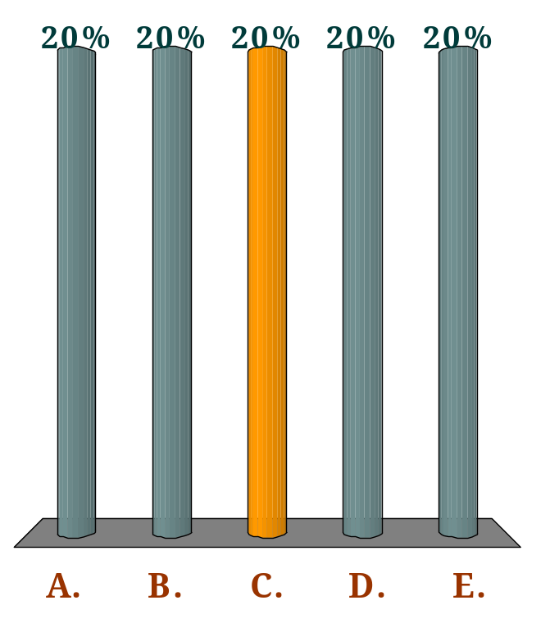
Given the following data about an economy
(in £bn), what is the level of national income?
Q
Saving | 100 | Consumption | 350
Exports | 200 | Imports | 250
Net tax revenue | 120 | Government expenditure | 140
Investment | 130
£470bn
£480bn
£570bn
£670bn
£820bn

Slide 37
Taking account of inflation
If we are to make a sensible comparison of one year’s national income with another, we must take inflation into account.
Nominal GDP
    GDP measured at current prices.
Real GDP
  GDP after allowing for inflation.
  GDP measured in constant prices: i.e. in terms of the prices ruling in some base year

Slide 38
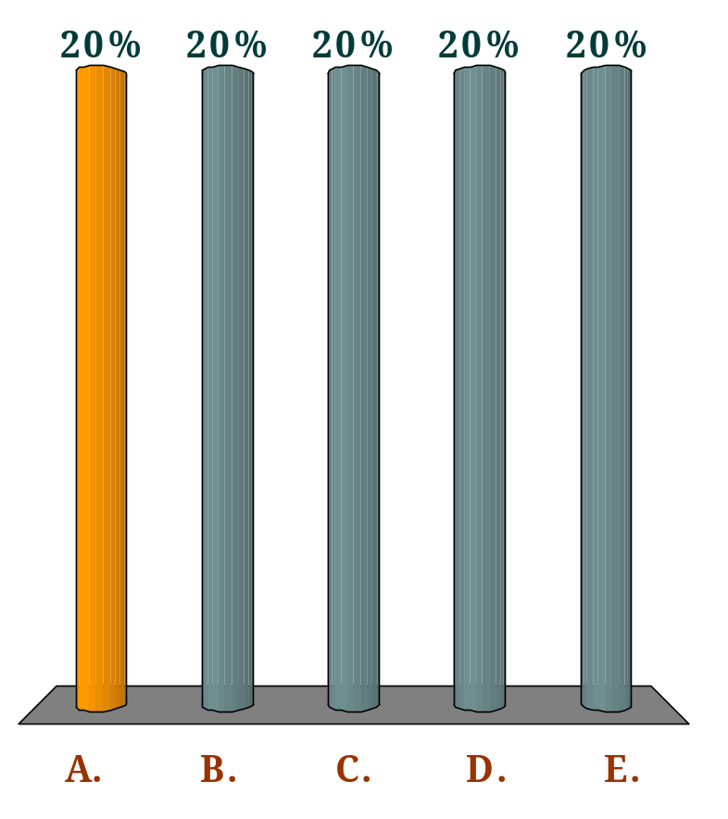
If, over the past year, nominal GDP has risen by 5% and inflation has been 2%, which of the following is true?
Q
Real GDP has increased by 3%.
Real GDP has increased by 5%.
Real GDP has decreased by 2%.
Real GDP has decreased by 3%.
It is impossible to say what has happened to real GDP.

Slide 39
Taking account of population: the use of per-capita measures
GDP is a measure of total national income (output)
GDP per Capita or Per capita income
  Is output or income per head
  It’s calculated GDP divided by total population
  Useful for comparing living standards of different countries

Slide 40
Problems of measuring national output
the problem of double counting
  Recording intermediate goods twice with the consequence that the GDP is overstated.
  Can be avoided by counting only final products or
  By measuring the value added at each stage of production
Non-marketed items such as ‘do-it-yourself’ and other home-based activities
The ‘underground’ economy
  consists of illegal and hence undeclared transactions

Slide 41
……Something to Think About…….
Are GDP statistics good indicators of welfare?

Slide 42
……..GDP figures Ignore…….
    human costs of production
      i.e Increases in GDP means reduced leisure hours
    Externalities
      i.e. pollution, ozone layer depletion global warming etc.
    the production of ‘regrettables’ leads to increases in GDP
      Faster growth leads to more crimes and more expenditure
      on security
    distribution of income
    production does not equal consumption
      Greater part of GDP may be exported or invested

Slide 43
The National Economy
Short-term Growth and the Business Cycle

Slide 44
The distinction between actual and potential growth
Actual output is national output that is actually produced.
actual growth
    the % annual increase in national output actually produced

Slide 45
………Potential output and growth
Potential output is the output that could be produced in the economy if there were a full employment of resources.
potential economic growth is the speed at which the economy could grow
  the % increase in the economy’s capacity to produce
Major factors contributing to potential economic growth
  An increase in resource i.e. Ghana’s oil discovery
  An increase in the efficiency through technological advancement, improved labor skills etc.

Slide 46
Output Gap
Output Gap is the difference between actual and potential output
When actual output exceeds potential output the gap is positive
When the potential output exceeds the actual output there is probably an increase in unemployment
There is a negative gap
To close a negative the actual growth rate must exceed the potential growth rate

Slide 47
Which one of the following is definitely true?
Q
Actual growth can never be greater than potential growth.
Actual output can never be greater than potential output.
If potential output exceeds actual output there is a negative output gap.
If actual growth exceeds potential growth there is a positive output gap.
All of the above.

Slide 48
Growth and the production possibility curve
Growth in
actual output
Good X
c
b
a
O
Good Y

Slide 49
Growth and the production possibility curve
Growth in
potential output
Good X
x
I
II
O
Good Y

Slide 50
Growth and the production possibility curve
Growth in
actual and
potential output
y
Good X
x
I
II
O
Good Y

Slide 51
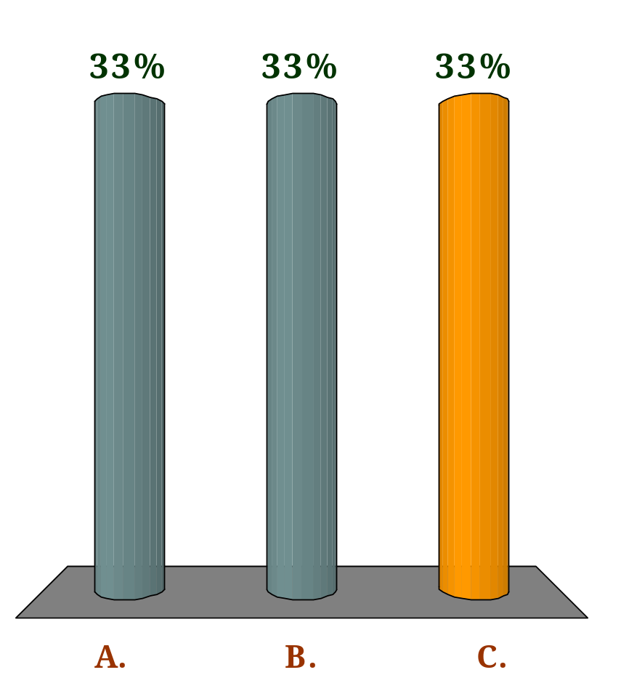
If there is an increase in potential output there will be a parallel outward shift in the production possibility curve.
Q
Always
Never
Possibly

Slide 52
........The business cycle..........
Actual growth tends to fluctuate. A country experiences
  boom when actual growth is high
  Recession when actual growth is negative
Business cycle or trade cycle refers to the periodic fluctuations of national output round its long-term trend.

Slide 53
The business cycle
Full-capacity
output
Peaking out
National output (GDP)
recession
Actual
output
Expansion
Upturn or Trough
O
Time

Slide 54
The phases of the business cycle
The upturn or recovery
  In this phase, a contracting or stagnant economy begins to recover, and growth in actual output resumes.
Expansion
  During this phase, there is rapid economic growth: the economy is booming.
  A fuller use is made of resources
  the gap between actual and potential output narrows.

Slide 55
The phases of the business cycle
The peaking out
  During this phase, growth slows down or even ceases.
4. The slowdown or recession or slump
  During this phase, there is little or no growth or even a decline in output.
  Increasing slack develops in the economy
The length of a business cycle is measured from trough to trough

Slide 56

The length of a business cycle could be measured from:
Q
peak to peak.
peak to trough.
trough to peak.
point of most rapid growth to point of most rapid decline (or slowest growth).
Any of the above

Slide 57
The irregularities are due to……
the length of the phases
  Some booms (and reccessions) are shortlive, lasting only few months
  Others are much longer, lasting over several years
the magnitude of the phases
  Some booms (and recessions) occur at high rates, say 4% or more per annum
  On other occasions growth is much gentler and can even stagnate.

Slide 58
Causes of fluctuations in growth
changes in aggregate demand (AD= C+I+G+X-M)
  A rapid rise in aggregate demand will create shortages.
  This will tend to stimulate firms to increase output, thus reducing slack in the economy
changes in aggregate demand relative to potential output
  Without an expansion of potential output, rises in actual output would eventually come to an end, as spare capacity is used up.
Two determinants of growth in the long run
  Growth in aggregate demand
  Growth in potential output

